Slide 1
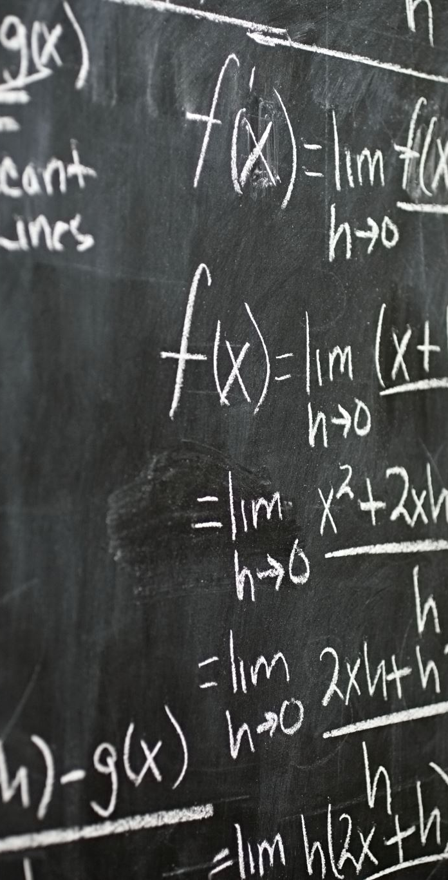
Everybody Counts
Maths Revision Session- Year 10

Slide 2
Session Agenda
Y10 Mocks information
Revision in lessons
Revision at home
Any questions

Slide 3
AQA 8300
Year 10 End of year Mocks
Friday 19th June afternoon session
Non-calculator 1½ hours
Foundation: grades 1 to 5
Higher: grades 4 to 9

Slide 4
AQA 8300
Year 11
November Mocks
Foundation: grades 1 to 5
Paper 2- Calculator 1½ hours
Paper 3- Calculator 1½ hours
Higher: grades 4 to 9
Paper 2- Calculator 1½ hours
Paper 3- Calculator 1½ hours
Both of these are calculator papers

Slide 5
AQA 8300
Year 11
February Mocks
Foundation: grades 1 to 5
Non-calculator 1½ hours
Higher: grades 4 to 9
Non-calculator 1½ hours

Slide 6
Equipment needed for GCSE Maths Exams
Pen/pencil/ruler/rubber
Protractor
Compass
This mock is a non-calculator mock so no calculators are needed

Slide 7
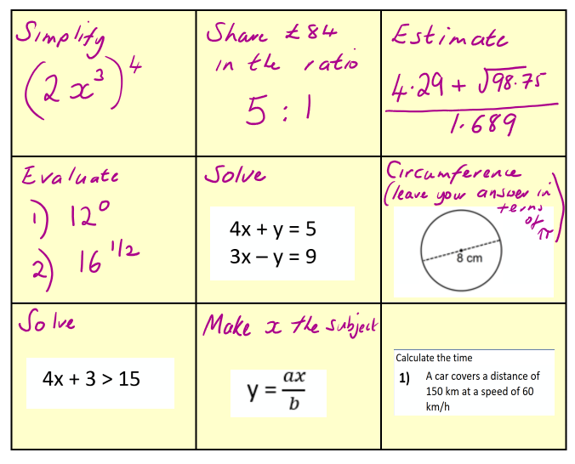
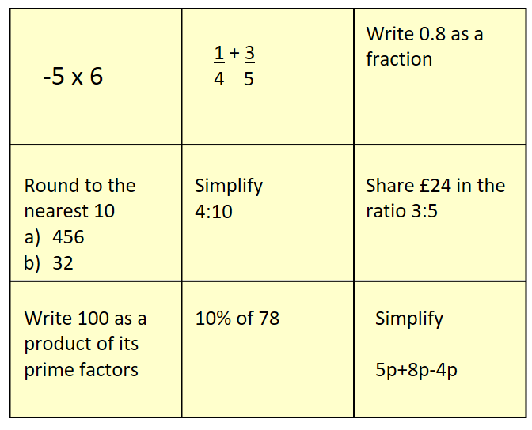
Revision in lessons
Revision grids will start w/c 18th May 2026
Higher example
Foundation example

Slide 8
Revision in lessons
Written revision sheets
Will start after the half term break
There are three parts to this:
Revision cards
Practice questions
Exam style questions

Slide 9
Revision cards
How they work
Question on one side
Answers on the other
The idea is students can quiz themselves on the key knowledge they need to for test.
You can help with this at home.

Slide 10
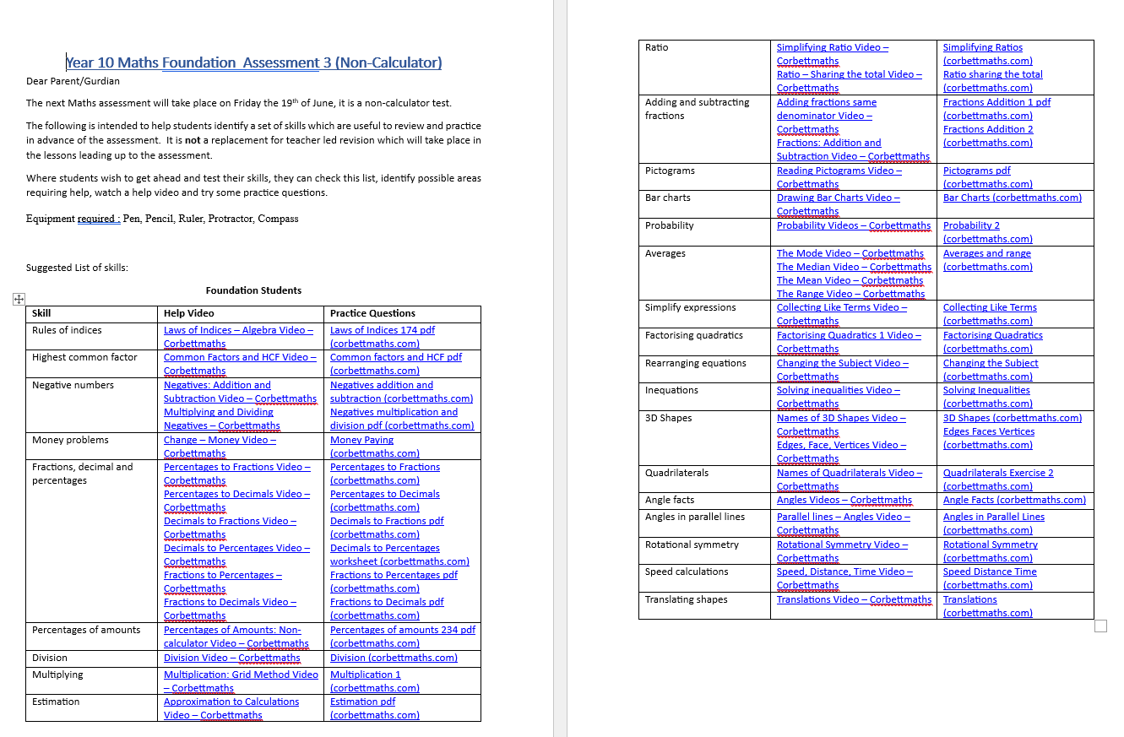
Revision at home
You will have already received am email with the topic list and video links.
Please encourage your child to watch these videos and complete the practice questions.

Slide 11
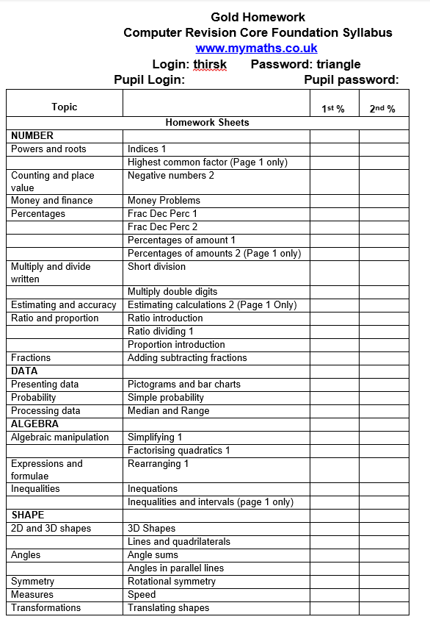
Revision at home
Most classes are making their way through the MyMaths revision list for their homework.
Please encourage your child to be completing their weekly homework- as this will help them for their end of year test.

Slide 12
Extra websites students could use:
www.mymaths.co.uk
Login: thirsk Password: triangle
www.corbettmaths.com
No login needed
www.mathsgenie.co.uk
No Login needed
Notes:
2497 yes

Slide 13
Beyond GCSE
All students continue to study maths if they don’t have a GCSE grade 4 or above
If your son/daughter is expressing an interest in
AS Mathematical Studies (Core Maths)- minimum requirement is grade 5
A level Maths -minimum requirement is grade 7
A Level Further Maths- minimum requirement is grade 8

Slide 14

Any Questions?

Slide 15
Everybody Counts

